Slide 1

Investigation of Visual Bias In Generative AI
Jerome Agius – B.Sc. IT (Hons) Artificial Intelligence

Slide 2

Motivation
Bias affects the applicability of applications
Affecting people's lives (Recidivism Scoring/Credit Scoring)
Bias needs to be addressed in AI systems particularly in generative endeavours and visual datasets.
Initial research goal (LAION-5B & Stable Diffusion)
Expanded research goal (LAION-400M & Stable Diffusion/Dall-E/Midjourney)

Slide 3
AIMS and Objectives
Identify the severity of bias within the generative models and LAION-400M dataset.
Objectives:
Determine the types of bias assess.
Determine what bias measurements to utilise.
What Images to assess?
How should the images be annotated?

Slide 4
Research
Biases (Gender/Race/Age/Prominence)
Measurements (Count/Correlation/Shannon Entropy/Simpson Index/Evenness/Centre Distances/Percentage Area)
Innately biased images (Doctor/Nurse/Both)
Doctors – Male/White/Younger than 55
Nurse – Female/White/Younger than 55
Computer Assisted Annotation (DeepFace/FairFace)
Biased Models -> Impact results.
Human Annotation -> Serves as baseline.

Slide 5
Implementation
Image Generation
Image Annotation
Metric Extraction
Conclusion

Slide 6

Image Generation
Prompt - ”A picture of a [subject] facing forward”
Negative Prompt - ”Disfigured” and ”Art”
Prompt Alteration (Dall-E)
No. of Images
Image Retrieval
Tagged (Doctor/Nurse)
Manual Filtering
Random Selection
No. of Images

Slide 7









Stable Diffusion Images

Slide 8









Midjourney Images

Slide 9









Dall-e Images

Slide 10
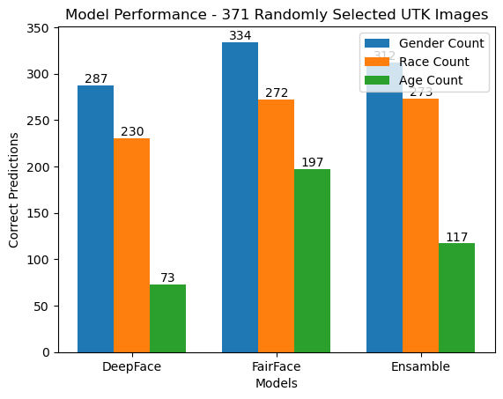
Annotation
UTK-Face Dataset
Main model (FairFace)
Ensemble model abandoned
Labels
Gender – Male/Female
Race – Asian/White/Middle Eastern/Indian/Black/Latino Hispanic
Age – 0-2/3-9/10-19/20-20…60-69/70+

Slide 11


Metric Extraction
Image
Labels
{‘age’: label, ‘gender’: label, ‘race’: label, ‘centre_dist’: label, ‘space’: label}
Confidence
{‘age’: confidence_dict, ‘gender’: confidence_dict, ‘race’: confidence_dict}

Slide 12
Conclusion
Image Generation -> Annotation -> Metric Extraction -> Conclusion
Dwa
Dawd
Dawd
Dawd
daw

Slide 13

OVERCOMING NERVOUSNESS
CONFIDENCE-BUILDING STRATEGIES

Slide 14
SELECTING VISUAL AIDS
ENHANCING YOUR PRESENTATION

Slide 15
EFFECTIVE DELIVERY TECHNIQUES
Effective body language enhances your message, making it more impactful and memorable.
Meaningful eye contact
Purposeful gestures
Maintain good posture
Control your expressions
This is a powerful tool in public speaking. It involves varying pitch, tone, and volume to convey emotion, emphasize points, and maintain interest.
Pitch variation
Tone inflection
Volume control

Slide 16
NAVIGATING Q&A SESSIONS
Know your material in advance
Anticipate common questions
Rehearse your responses
Maintaining composure during the Q&A session is essential for projecting confidence and authority. Consider the following tips for staying composed:
Stay calm
Actively listen
Pause and reflect
Maintain eye contact

Slide 17

SPEAKING IMPACT
Your ability to communicate effectively will leave a lasting impact on your audience
Effectively communicating involves not only delivering a message but also resonating with the experiences, values, and emotions of those listening

Slide 18
DYNAMIC DELIVERY
Learn to infuse energy into your delivery to leave a lasting impression
One of the goals of effective communication is to motivate your audience
Metric | Measurement | Target | Actual
Audience attendance | # of attendees | 150 | 120
Engagement duration | Minutes | 60 | 75
Q&A interaction | # of questions | 10 | 15
Positive feedback | Percentage (%) | 90 | 95
Rate of information retention | Percentage (%) | 80 | 85

Slide 19
FINAL TIPS & TAKEAWAYS
Consistent rehearsal
Strengthen your familiarity
Refine delivery style
Pacing, tone, and emphasis
Timing and transitions
Aim for seamless, professional delivery
Practice audience
Enlist colleagues to listen & provide feedback
Seek feedback
Reflect on performance
Explore new techniques
Set personal goals
Iterate and adapt

Slide 20
SPEAKING ENGAGEMENT METRICS
Impact factor | Measurement | Target | Achieved
Audience interaction | Percentage (%) | 85 | 88
Knowledge retention | Percentage (%) | 75 | 80
Post-presentation surveys | Average rating | 4.2 | 4.5
Referral rate | Percentage (%) | 10 | 12
Collaboration opportunities | # of opportunities | 8 | 10

Slide 21

THANK YOU
Brita Tamm
502-555-0152
brita@firstupconsultants.com
www.firstupconsultants.com

